Slide 1

Improving cyber resilience in the supply chain by sharing CYBER RESILIENCY CENTER BRAINPORT - for the high-tech industry in the Netherlands
MITRE ATT&CK conference may 9th 2019
Ewoud Smit – project team member Cyber Resiliency Center Brainport – Manager Cyber Defense Operations - ASML

Slide 2
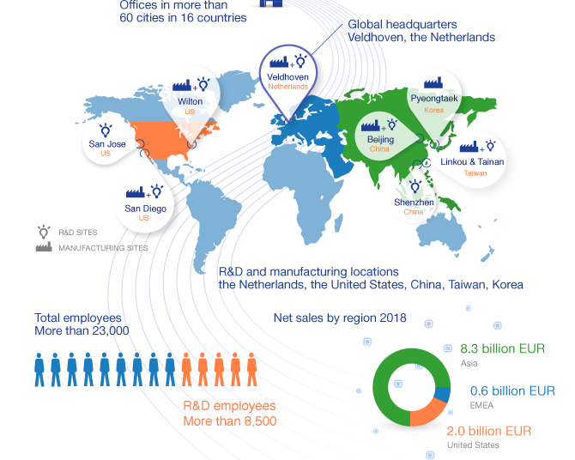
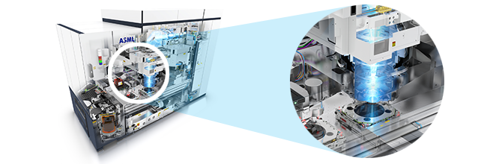
ASML & ATT&CK
Holistic Lithography company supplying key technology platform for Semiconductor industry
Intellectual property protection & delivery impact
CSIRT using ATT&CK for play development & gap analysis
Securing our own estate is not enough, collaboration & increasing resilience in the supply chain is key

Slide 3
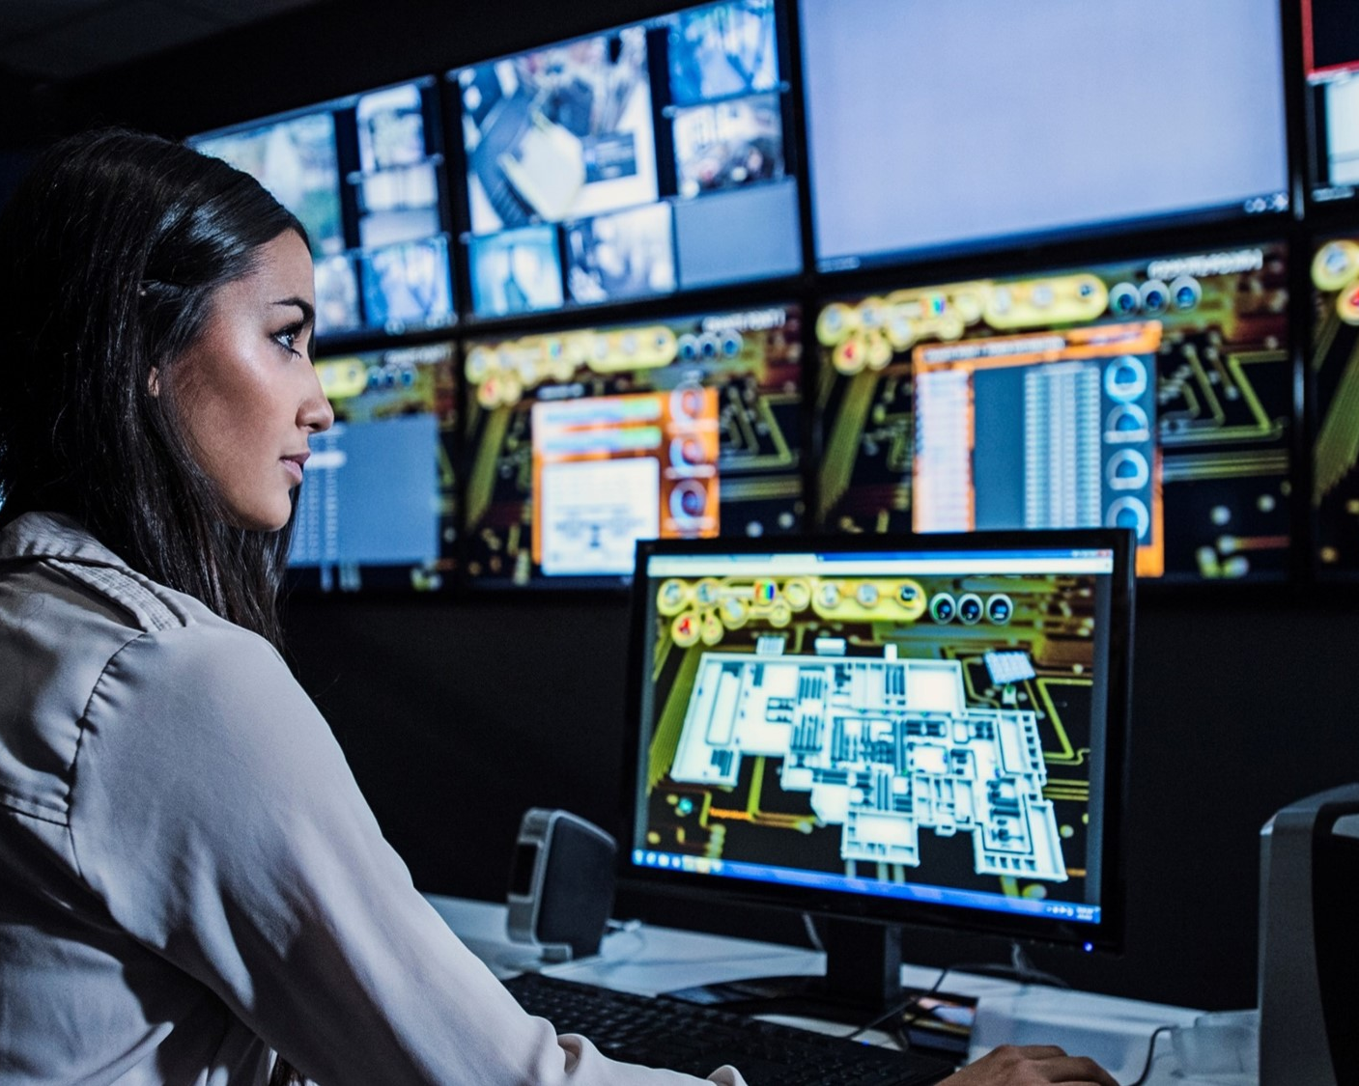
Topics
Why a Cyber Resiliency Center Brainport?
Approach
Offering (under development)
Lessons learned until now

Slide 4
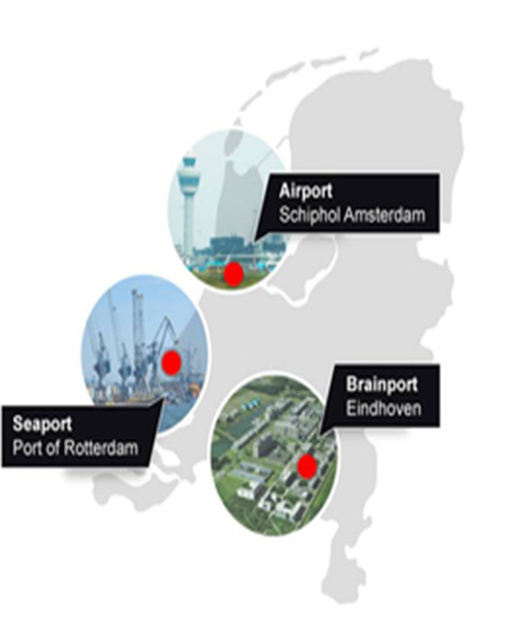
Dutch Cyber Security Council: Improve information exchange
Observations:
Urgency is high
Timely access to the correct information is paramount for the Cyber Resiliency of modern organizations
Cyber Resiliency is one of the cornerstones for a prosperous Netherlands
Advice: Improve information exchange by expanding the network of Information Sharing & Analysis Centers (like the ECSG)

Slide 5

Why a Cyber Resiliency Center Brainport?
What do we believe?
Digitization brings economic and social opportunities
But also threats, for instance through espionage and sabotage
Information exchange and cooperation are the key to Cyber Resiliency
For the Small & Medium enterprise in the high-tech industry it is near impossible to organize this independently
But is necessary to retain the ‘license to operate’
Sitting idle is not an option!

Slide 6

How did we set out to do this?
We build an organization with a cooperative philosophy
Together we create cyber resiliency in the Dutch high-tech industry starting with the Brainport region Eindhoven
We share information with each other. We use the Mitre ATT&CK framework as an ontology and common language framework.
We ensure we gain access to all relevant information. For this we use threat intelligence sharing and will use platform technologies (e.g. MISP).

Slide 7
Growth model Cyber Resilience Center Brainport
From TRUST to SHARING KNOWLEDGE and RESILIENCY
Logical steps:
Get to know each other and building trust (networking)
Daring to call and ask for help / sharing good practices
Good-practices database with tips& tricks
Threat-intelligence from open and closed sources
Connecting NCSC – AMBER information (official CERT)
Support & training preventative and after an incident
Shared monitoring / SOC service (no market disruption)
Generate and combine demand
Addition of
Brainport Industries
Members
Addition
supply chain ECSG
(Eindhoven region)
Building regional networks: TRUST
Cyber Resiliency Center for ECSG
Information sharing: KNOWLEDGE
- Building & Facilitating expert groups
- Get to know each other and Building trust
- Increasing Awareness
- Help each other in the supply chain / region
- Ad-hoc knowledge transfer
RESILIENCY
- Maintain lists of threat intelligence
- Structurally sharing threat intelligence
- Receiving code AMBER NCSC info
- Knowledge center of good-practices
- Creating & sharing of security advisories
- Alerting during targeted attacks on the sector(s)
- Supporting Awareness campaigns
- Tips & Tricks
- Training
ECSG
- Support Forensic investigations
- Technical advice during incidents
- Public relations support (incidents)
- Support in responding to threats
- Shared services (e.g. SOC) for supply chain partners

Slide 8
Services Cyber Resiliency Center Brainport
Five core themes
IDENTIFICATION
PROTECTION
DETECTION
RESPONSE
RECOVERY
Protect

Slide 9
Services Cyber Resiliency Center Brainport
Direct services from CWCB – part of general membership package
Intake (Healthcheck)
IDENTIFICATION
Sharing best-practices
Sharing contact details
Intervision groups
PROTECTION
Receiving Threat Intelligence from members
Receiving Open Sources Threat Intelligence
Receiving Closed / Payed sources Threat Intelligence
DETECTION
Referral to quality vetted and organization appropriate suppliers
RESPONSE
Sharing Threat Intelligence with Digital Trust Center
Annual Sectoral Threat overview report
Referral to quality vetted and organization appropriate suppliers
RECOVERY

Slide 10
Services Cyber Resiliency Center Brainport
Additional services on top of general membership – brokered by the Cyber Resiliency Center
Risk analysis on IT, OT, product software and/or the supply chain
Risk management strategy
Vulnerability scan & penetration tests
IDENTIFICATION
Implementing Intake advisory
Awareness & training
Support Implementing IT & OT
Identity & Access Mgt
Data protection
ISMS
Roadmap
PROTECTION
Managed Intrusion Detection System
Security Operations Center
DETECTION
Computer Emergency Response
Forensic Investigation
Communications Support
Improvement plan
Implementation Support
RESPONSE
Recovery support services
RECOVERY

Slide 11
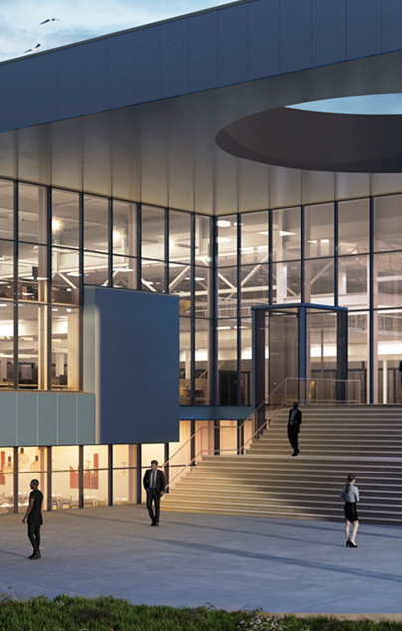
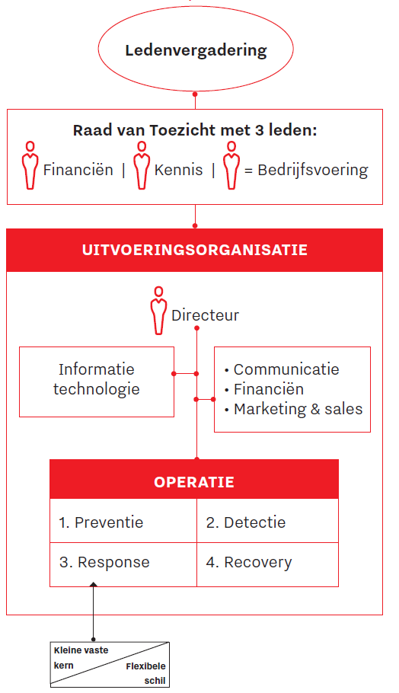
Future organizational model
A foundation with the DNA of a cooperation
Office at the Brainport Industries Campus (Eindhoven)
Lean & flexible support organization
Moderator for the online knowledge/sharing portal
Front office (services, marketing & sales)
Back office (IT, organization and administration)
Legal construct & governance
a Foundation (non-profit)
One director / chair
Supervisory Board of seven members
4 representatives from the “members”
3 topic specialists (Cyber, Accounting & Marketing)

Slide 12
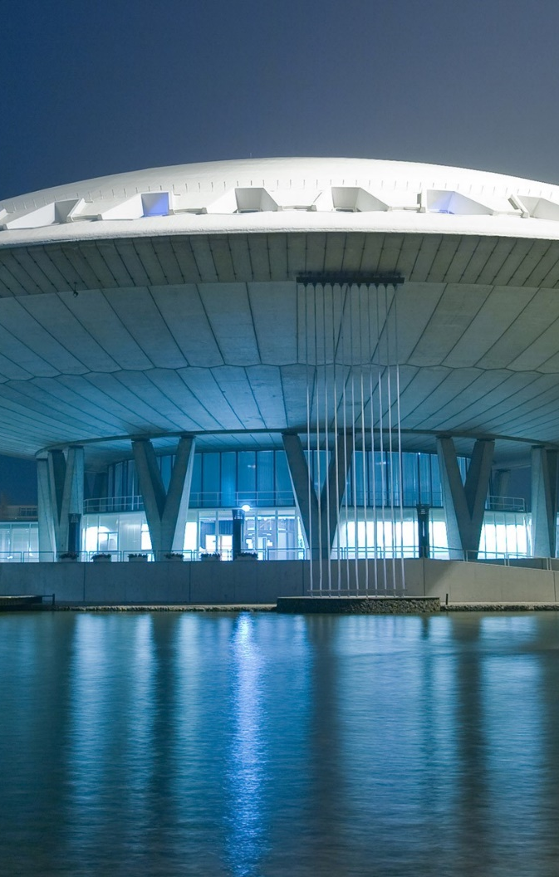
Lessons learned so far
Start with a small core group
Ensure sense of Urgency
Co-create with the target audience
Just do it, learn as you go

Slide 13

Questions?
Ewoud Smit– ewoud.smit@asml.com - 06 21 22 13 25
CYBER RESILIENCY CENTER BRAINPORT for the Dutch high-tech industry

